Slide 1
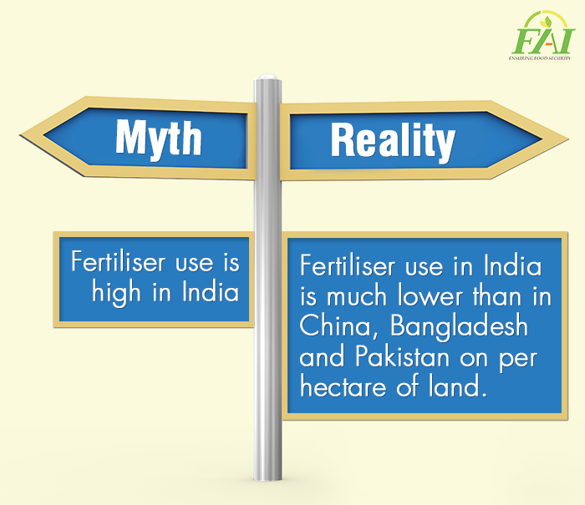
Myths and Facts
The commonly associated myths with Fertiliser and clearing them with actual facts so as to educate people
Post
Myth: Fertiliser use is high in India.
Reality: Fertiliser use in India is much lower than in China, Bangladesh and Pakistan on per hectare of land.

Slide 2
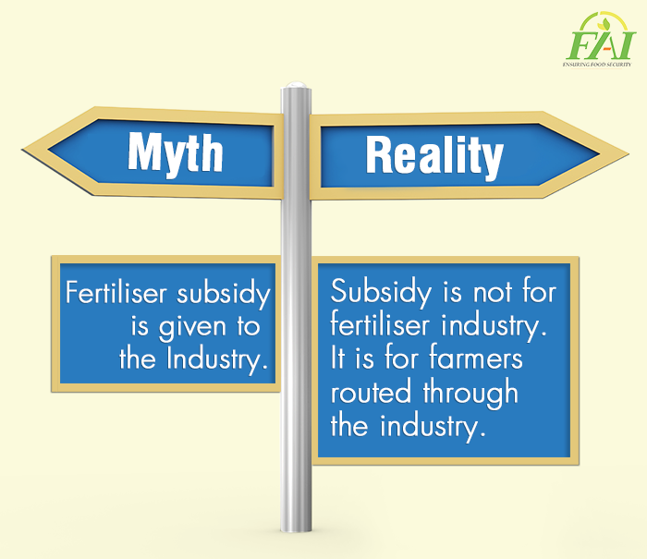
Myths and Facts
The commonly associated myths with Fertiliser and clearing them with actual facts so as to educate people
Post
Myth: Fertiliser subsidy is given to the Industry.
Reality: Subsidy is not for fertiliser industry. It is for farmers routed through the industry.

Slide 3
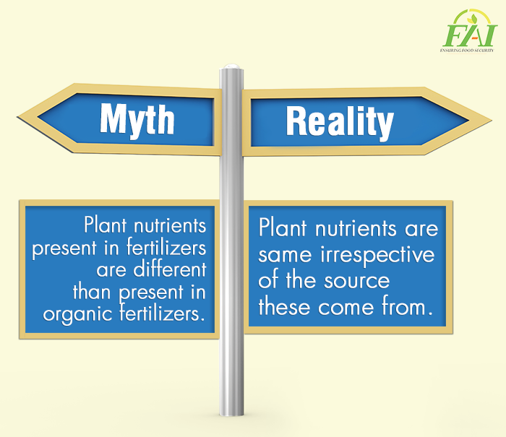
Myths and Facts
The commonly associated myths with Fertiliser and clearing them with actual facts so as to educate people
Post
Myth: Plant nutrients present in fertilizers
are different than present in organic fertilizers.
Reality: Plant nutrients are same irrespective
of the source these come from.

